Slide 1
Week 1
Understanding the Challenge and Sustainable Development
Notes:
These are the slides for Week 1 of the Corporate Sustainability Leadership Education Program Online Class. Our topic this week is: Understanding the Challenge and Sustainable Development.

Slide 2
Session Outline
Understanding the Challenge
Global Trends
The “Wicked Problem”
Understanding Sustainable Development
What is Sustainable Development?
The Triple Bottom Line
Conclusion
Summary
Vocabulary Review
Required Materials
Supplemental Materials
Assignment
Notes:
This session will introduce the global challenge of sustainability.
In the first part of the session, we will cover global environmental and social trends that create a challenging situation, then we will talk about the concept of a “wicked problem” and how that concept helps us to understand the global challenge of sustainability.
In the second part of the session, we will cover sustainable development – what is it and why does it matter? This section will introduce the concept of the Triple Bottom Line and how it can guide sustainable business practices.
The session will conclude with the thought that sustainability presents both a challenge and an important opportunity for all sectors, but the business sector in particular.
After the conclusion of the slides, there will be a summary that includes a review of vocabulary, a list of required readings and videos, and your assignment for this week.

Slide 3
Learning Objectives
By the end of this session, you will be able to:
Recognize major global social and environmental trends
Understand the concept of “wicked problem” and give examples
Define sustainable development and give examples of sustainable development goals
Use the concept of the Triple Bottom Line to identify economic, social, and environmental trade-offs and overlaps
Notes:
By the end of this session, you will be able to:
Recognize major global social and environmental trends
Understand the concept of “wicked problem” and give examples
Define sustainable development and give examples of sustainable development goals
Use the concept of the Triple Bottom Line to identify economic, social, and environmental trade-offs and overlaps

Slide 4
Understanding the Challenge
Global Trends and Wicked Problems
Notes:
Understanding the Challenge: Global Trends and Wicked Problems
This section of the presentation will explore the difficulties presented by trends that show more and more people living on a limited and changing planet.

Slide 5
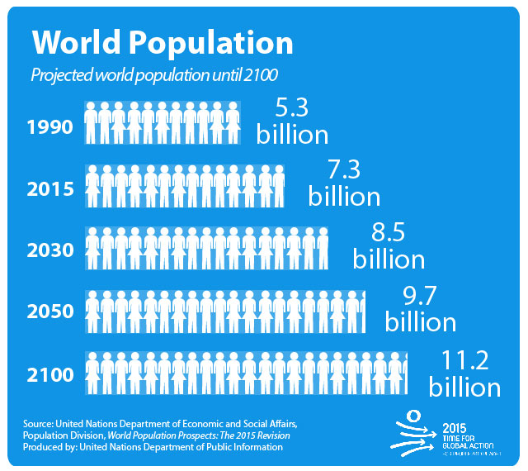
Population Growth
Notes:
Population is an estimated 7.3 billion and growing, though increasing at a slower rate. As you can see here, by 2050 we are expected to have another 2.4 billion people on the planet for a total of 9.7 billion.
Image source: http://www.un.org/News/dh/photos/large/2015/July/Population-Infographic-01.jpg

Slide 6
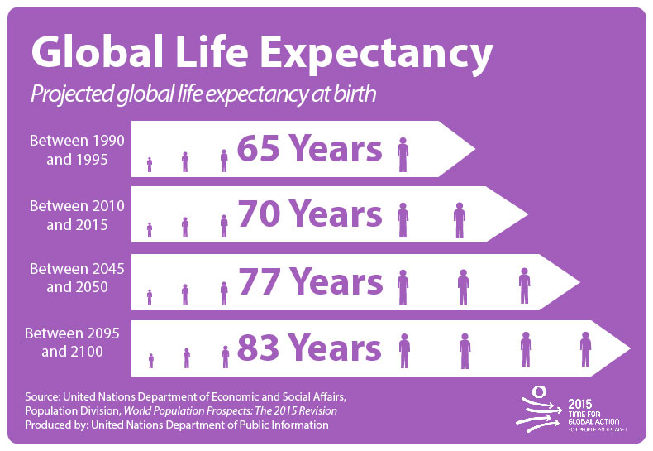
Population Growth
Notes:
At the same time, life expectancy is rising globally, meaning people live longer. This is of course good news, that people live longer - but it does mean more resources are needed over the longer course of a person’s life.
Image source: http://www.un.org/News/dh/photos/large/2015/July/Population-Infographic-02.jpg

Slide 7
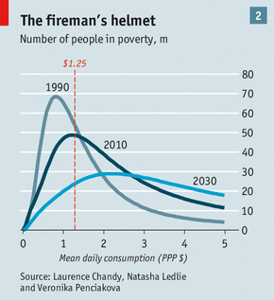
Decrease in Extreme Poverty
Notes:
The last 25 years have seen extreme poverty is decreasing, particularly in Asia. This, too, is a good thing – more people are able to meet their daily needs for food, water, and shelter.
Image source: http://www.economist.com/news/briefing/21578643-world-has-astonishing-chance-take-billion-people-out-extreme-poverty-2030-not

Slide 8
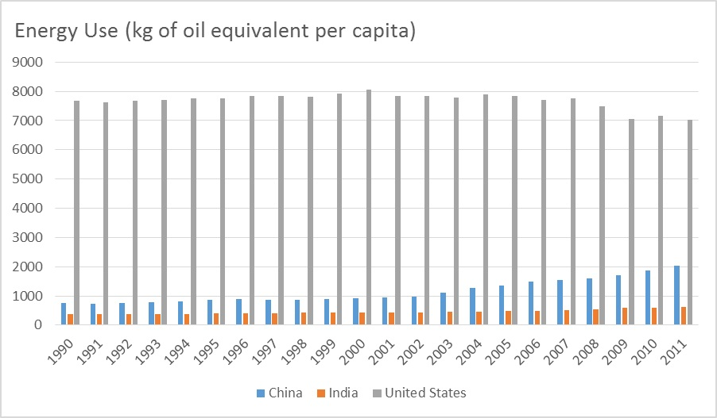
Development → Consumption
Notes:
The only potential problem is that historically, development – that is, decreased poverty – has tended to lead to more resource consumption. Wealthier societies have tended to consume more – more food, more water, more energy.
For instance, this chart shows the energy use of US, China, and India. Notice that the US’s energy consumption is far more than either China or India. Notice, too, that China’s energy use creeps up as its economy grows.
Though development does not always lead inevitably to more consumption, there is a concern that development on a global scale might lead to the demand for more resources than the planet has available.
Image source: http://oilprice.com/Energy/Energy-General/Access-To-Energy-Explains-Unequal-Growth-Rates-of-India-and-China.html

Slide 9
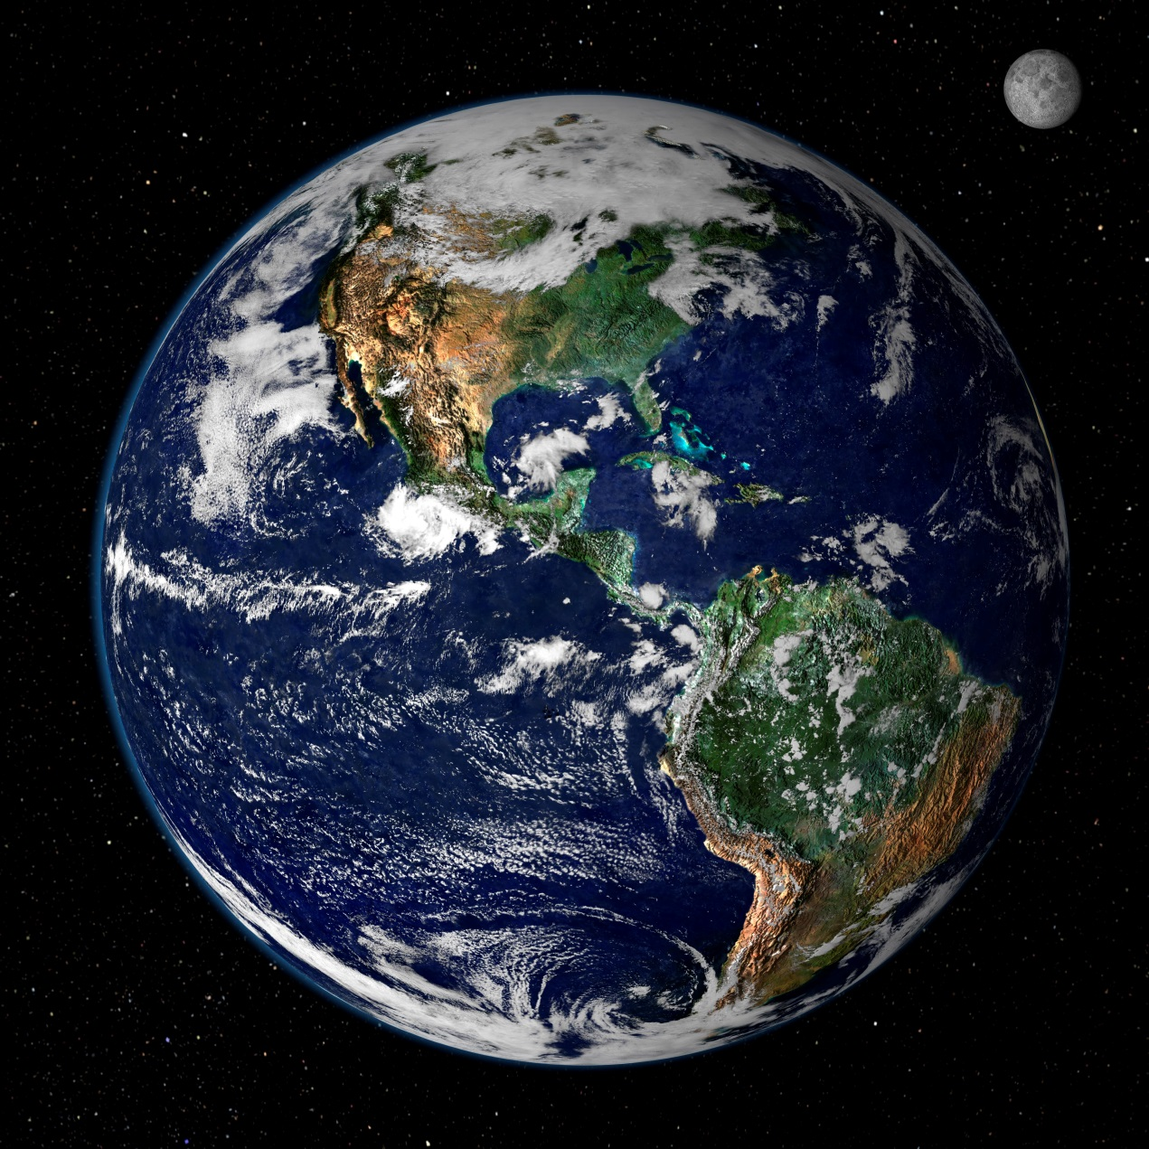
Development → Over-Consumption
Notes:
In fact, some experts estimate that if everyone in the world consumed as much as Americans do, we would need 4 Earths. Russia, in contrast, has a smaller ecological footprint than its biocapacity – if everyone lived like Russians, we would need less than the entire Earth
If the population increases and if this trend of development and consumption continues, then we will face resource depletion on an ever-growing scale.
Image source: https://upload.wikimedia.org/wikipedia/commons/d/db/Nasa_blue_marble.jpg

Slide 10
The Challenge
How will a growing population live on a polluted, finite, and changing planet?
Pollution and toxic waste
Deforestation and biodiversity loss (extinction)
Energy demand
Water scarcity
Food security
Climate change
Notes:
The challenge, then, is this: How will a growing population live on a polluted, finite, and changing planet? That is the basic overall challenge, but it is defined by smaller, interconnected challenges that we will now explore briefly:
Pollution and toxic waste
Deforestation and biodiversity loss (extinction)
Energy demand
Food and Water Security
Climate change
All of these issues represent challenges – but also opportunities.

Slide 11
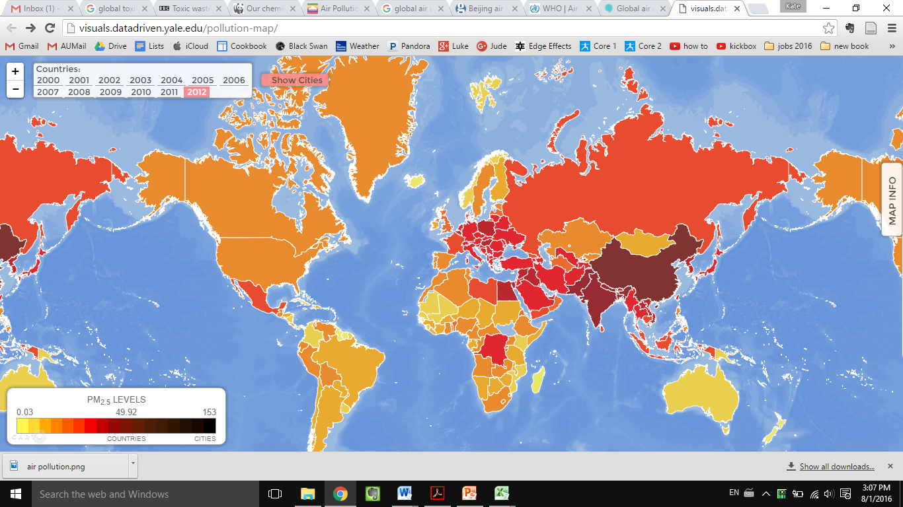
Air Pollution
Notes:
Air pollution.
Over 80% of people living in cities have air quality levels that exceed the limits set by the World Health Organization. In most cities around the world, air pollution is getting worse, though in some wealthier regions it is getting better.
Image source: http://visuals.datadriven.yale.edu/pollution-map

Slide 12
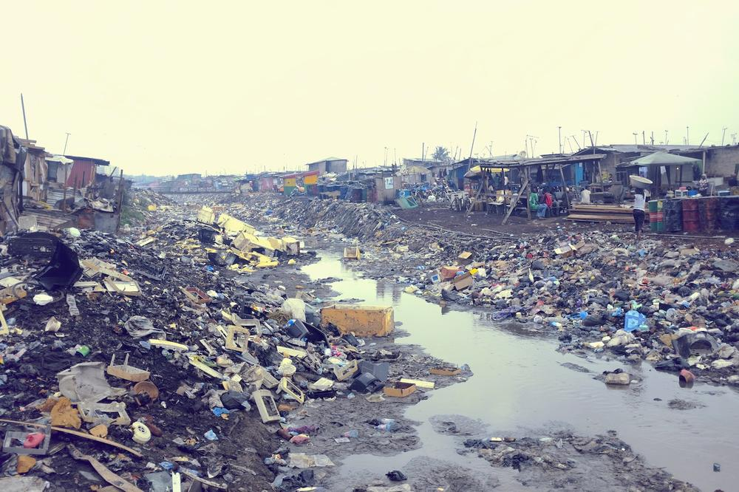
Toxic Waste
Notes:
Toxic waste is another challenge.
More than 200 million people around the world are at risk of exposure to toxic waste. This image is of Agbogbloshie in Ghana, the world’s biggest e-waste dump. People here and in many poor areas around the world burn e-waste to recover the metals used in electronics. When they do, they release toxins into the water, ground, and air.
As with air pollution, the poorest countries are most likely to be exposed to toxic waste – and toxic waste dumps are only expected to grow as consumption of electronic goods increases.
Image source: Kevin McElvaney/Al Jazeera (http://www.aljazeera.com/indepth/inpictures/2014/01/pictures-ghana-e-waste-mecca-2014130104740975223.html)

Slide 13
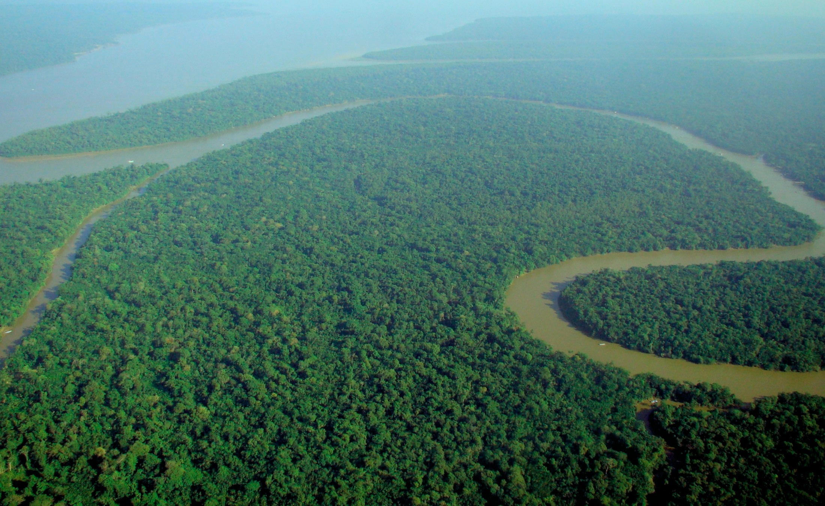
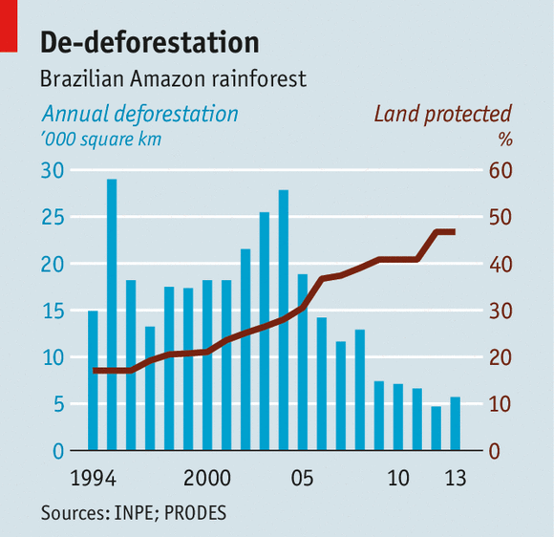
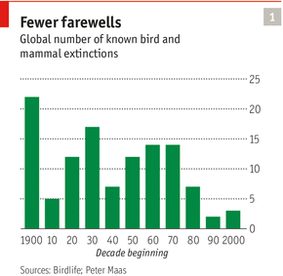
Deforestation and Extinction
Notes:
Deforestation and extinction have been environmental problems for many decades now, and they continue to be problems. However, there is some good news that the rates of deforestation and extinction are decreasing, as more forest are legally protected.
Image sources:
Rainforest: https://upload.wikimedia.org/wikipedia/commons/d/d0/Aerial_view_of_the_Amazon_Rainforest.jpg
De-deforestation: http://www.economist.com/news/science-and-technology/21603409-how-brazil-became-world-leader-reducing-environmental-degradation-cutting
Fewer farewells: http://www.unisi.it/sites/default/files/allegatiparagrafo/theeconomist_20130914_biodiversity_0.pdf

Slide 14
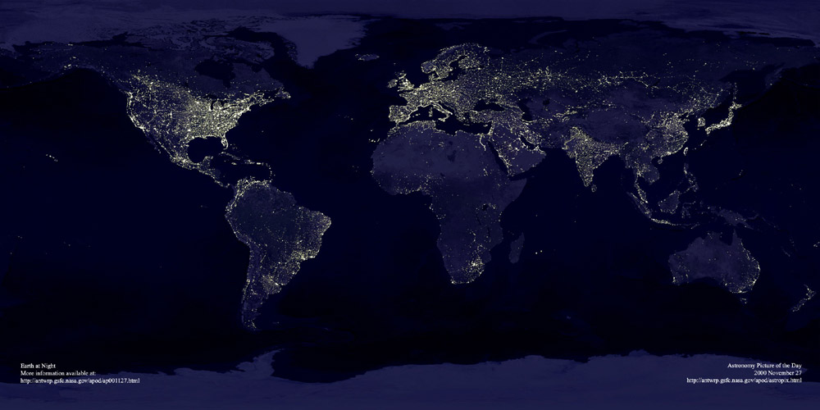
Energy Demand
Notes:
Energy is and will continue to be an important challenge.
Currently, 1.2 billion people, this is mostly in sub-Saharan Africa and developing Asia, live in what is called “energy poverty” – they do not have access to electricity or fuel for cooking. Energy poverty means that it is difficult to learn, work, cook, or provide medical care.
Image source: http://www.princeton.edu/~ina/images/infographics/lights_earth.jpg

Slide 15
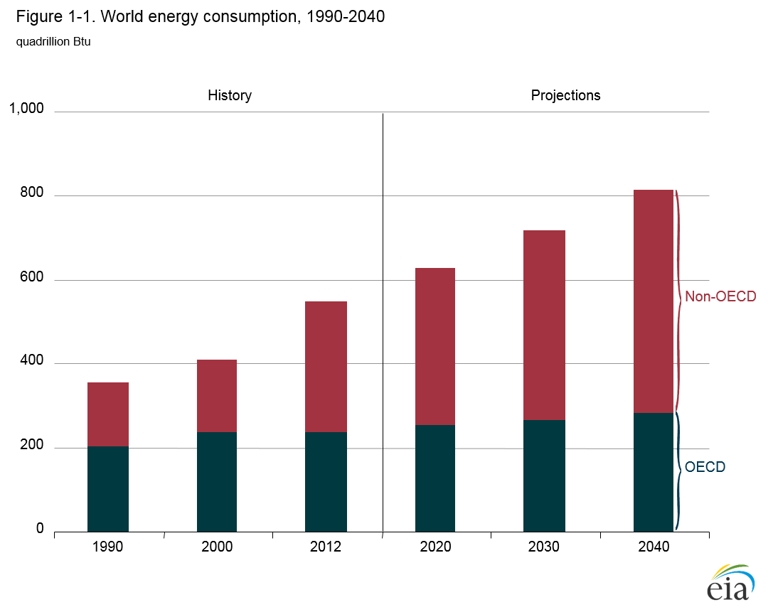
Energy Demand
Significant growth is projected in the next 25 years, particularly in Asia and the Middle East.
Notes:
Given the fundamental importance of energy, and the expectation of growing population and growing wealth, the worldwide demand for energy of all types is expected to grow significantly in the coming years.
In the next 20 years, total energy demand is expected to increase by over 30%, while demand just for electricity is expected to grow by 70%. China, India and the Middle East will account for most of the increase.
The question then becomes: where will this energy come from? Will it contribute to climate change?
Image source: http://www.eia.gov/forecasts/ieo/world.cfm

Slide 16
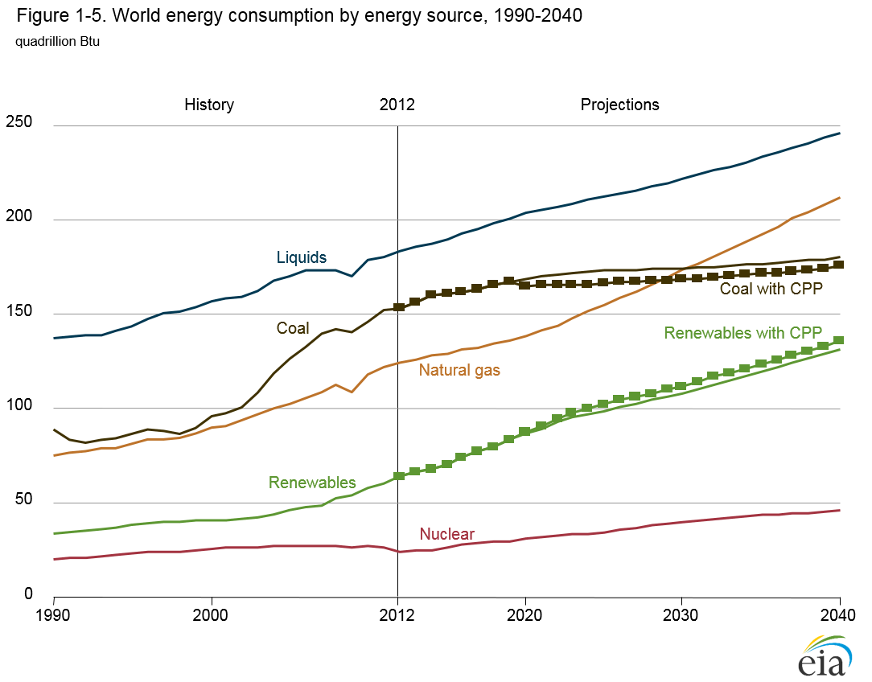
Energy Demand
Growth is projected in all energy sources – fossil fuels and renewables.
Notes:
Given this increase in energy demand, experts expect consumption of all sources of energy – fossil fuels like coal, oil and gas, and renewables – to increase.
Image source: http://www.eia.gov/forecasts/ieo/world.cfm

Slide 17
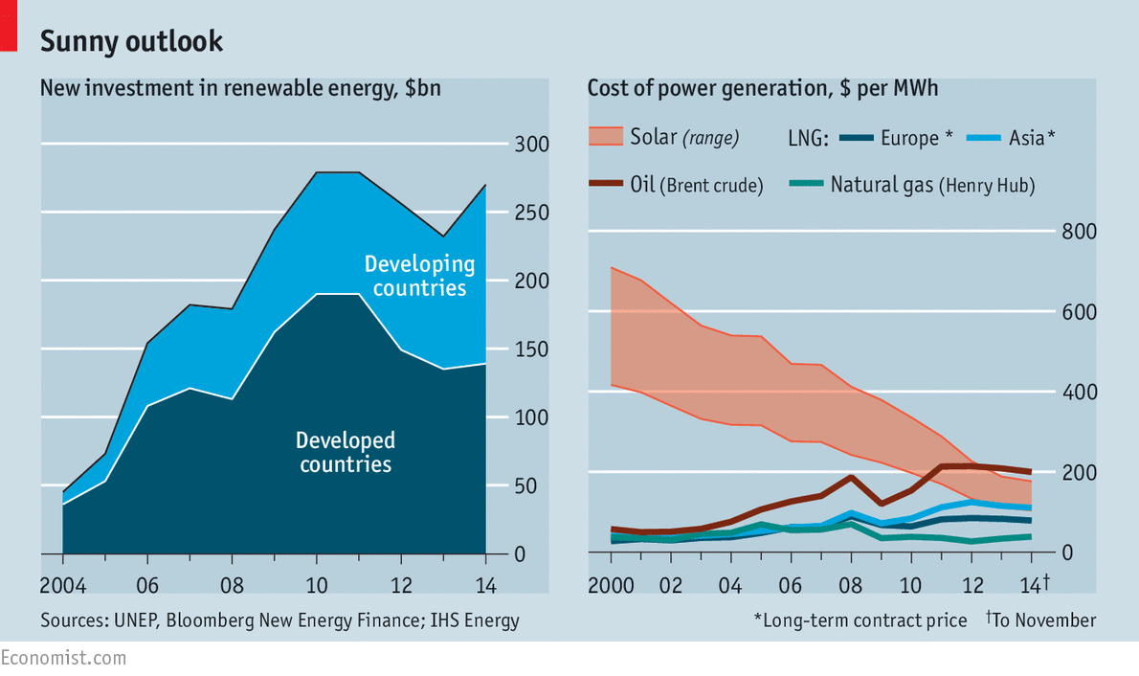
Energy Demand
Investment in renewables has grown, and the cost of solar power has come down.
Notes:
The good news in energy is that the last 10 years have seen a growth in investment in renewables, particularly solar photovoltaic technology. The cost of producing solar power has come down.
Use of renewables has grown particularly in Africa and Latin America. Renewables are estimated to make up a fifth of global energy production by 2030.
Image source: http://www.economist.com/blogs/graphicdetail/2015/04/daily-chart-6

Slide 18
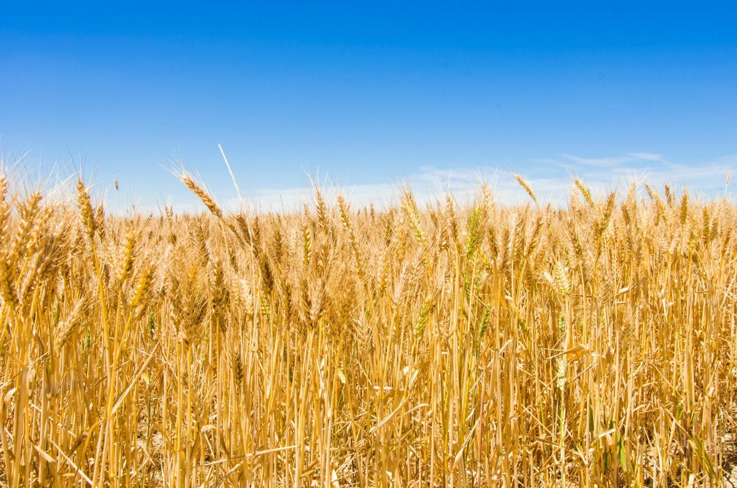
Food and Water Security
Notes:
Food and Water are closely linked, and the security of both in the coming decades is potentially at risk. Already, 1.8 billion people world-wide do not have access to clean water, while roughly 800 million do not have access to nutritious food. How do we ensure a growing population has sufficient food and water?
Image source: https://www.agric.wa.gov.au/sites/gateway/files/Wheat%20_Z056804_0.jpg

Slide 19
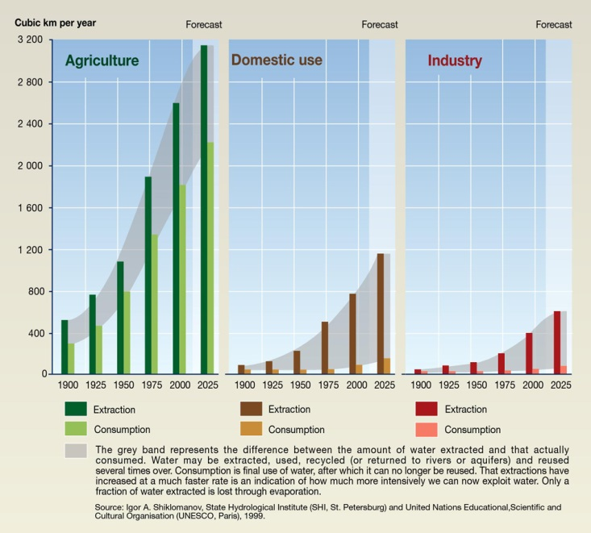
Food and Water Security
Irrigation for agriculture accounts for 70% of water withdrawals globally and up to 90% in the poorest countries.
Notes:
How are food and water closely connected?
For one thing, producing food contributes to water problems. As this image shows, water use in agriculture is far greater than water use in the home or in industry. Irrigation for agriculture accounts for 70% of water withdrawals globally and up to 90% in the poorest countries.
Image source: http://www.unep.org/dewa/vitalwater/article43.html

Slide 20
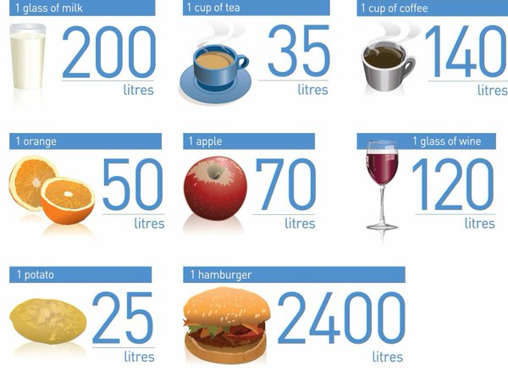
Food and Water Security
By 2050:
2.4 billion more people
60% more food needed
19% more water needed
Notes:
Enormous amounts of water are used to produce food, and meat especially. For example, one apple takes seventy liters of water to produce. A hamburger takes two thousand four hundred liters.
As the population grows – 2.4 billion more people by 2050 – we will need even more food, and even more water, land, and fertilizer to produce that food, and land and fertilizer on which to grow that food.
Image source: FAO: http://eumindgogreen13.weebly.com/uploads/5/1/2/6/51264535/7209274.jpg?1451479828

Slide 21
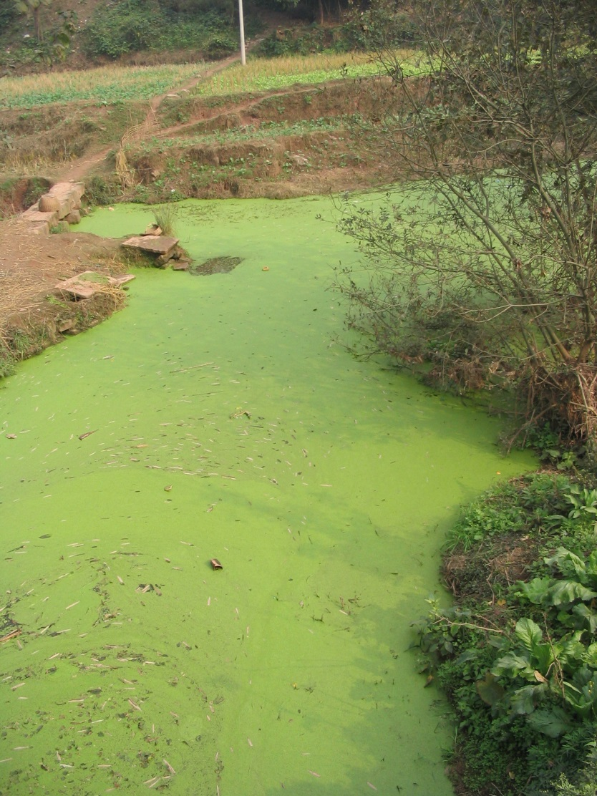
Food and Water Security
eutrophication
Notes:
Finally, fertilizers used in agriculture dump nitrogen into freshwater sources.
This is called eutrophication and it stresses or kills the species in the water. Besides making the water dangerous to human health, it can also affect already-vulnerable fish populations.
This, along with over-fishing and the acidification of the oceans, which results from the increased carbon dioxide in the atmosphere, is potentially leading to the collapse of the world’s fish population – a major food source.
Image source: https://upload.wikimedia.org/wikipedia/commons/7/74/River_algae_Sichuan.jpg

Slide 22
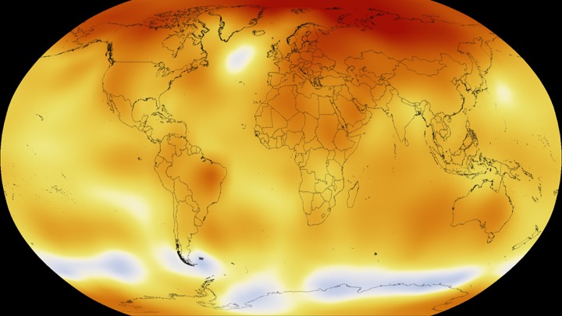
Climate Change
Notes:
One of the biggest challenges we face is, of course, climate change. Though climate change has many complex causes, it is important to recognize the role that energy plays, and will continue to play as a driver of climate change.
Image source: http://climate.nasa.gov/interactives/climate-time-machine

Slide 23
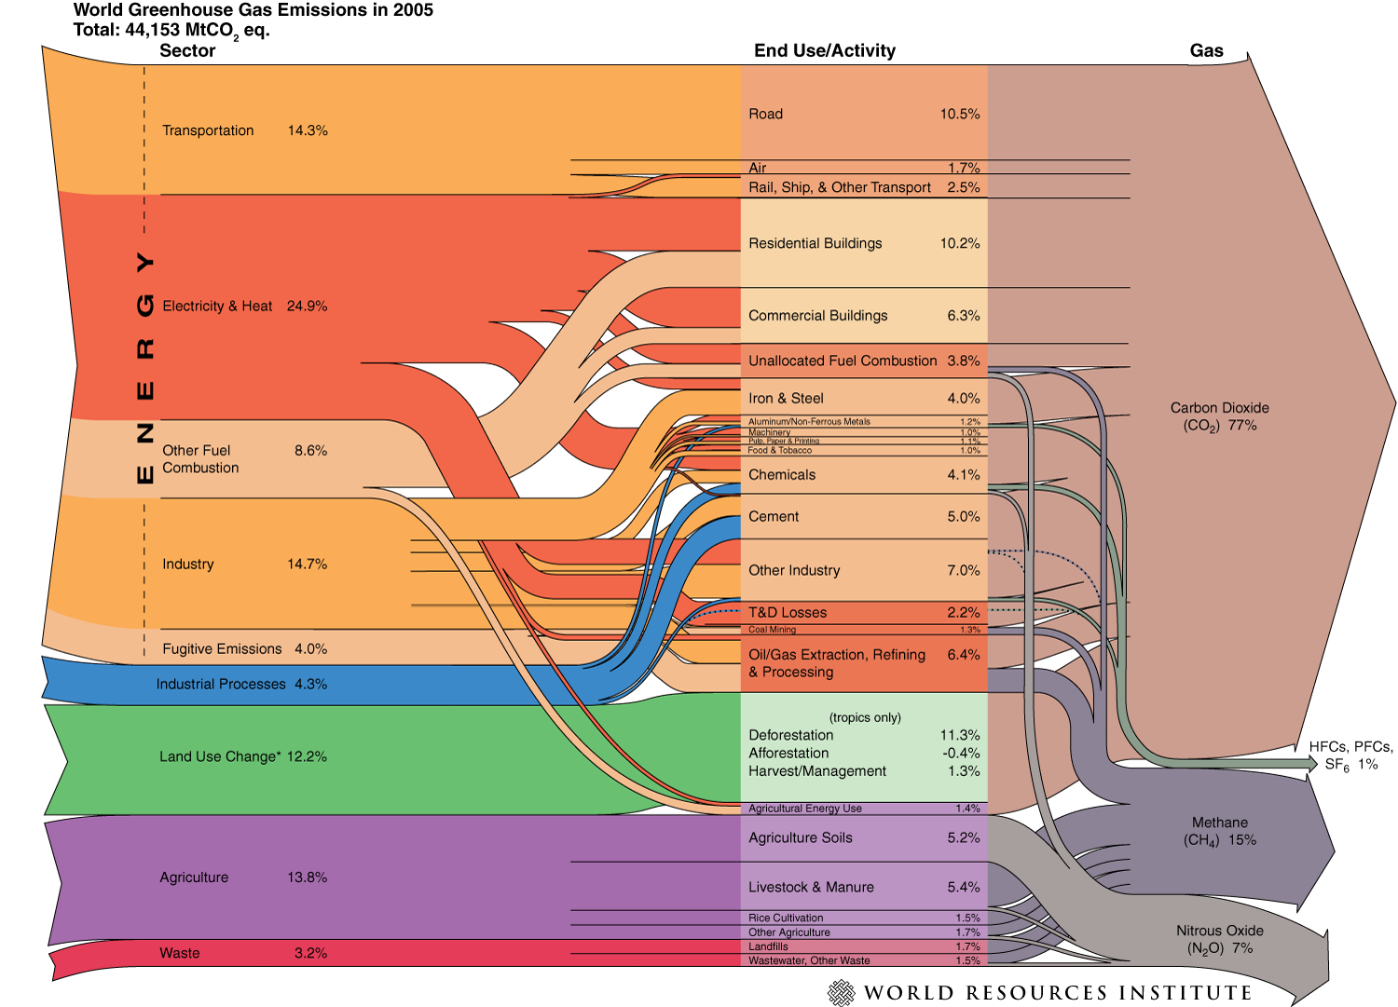
Climate Change
Notes:
This image, for instance, shows the major greenhouse gasses and which sectors contribute to them. Energy production – in orange here – clearly dominates the production of greenhouse gases, carbon dioxide especially.
Image source: http://www.wri.org/sites/default/files/world_ghg_flow_chart_2005.png

Slide 24
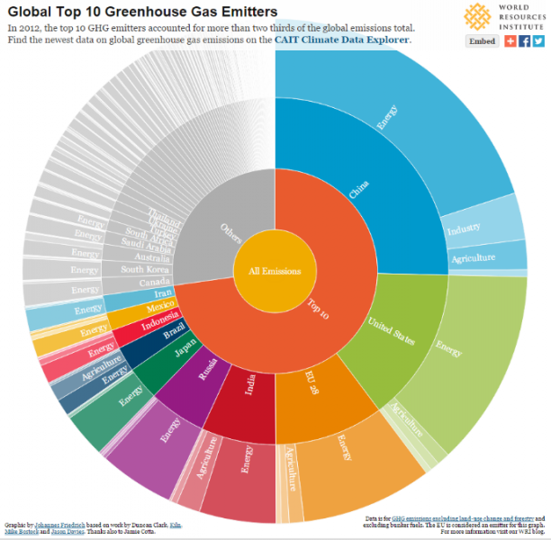
Climate Change
Top 5 Greenhouse Gas Emitters:
China
US
EU
India
Russia
Notes:
As for which countries are most responsible for emitting greenhouse gases, as this image shows, the top five are China, the US, the EU, India, and Russia. In all of these countries, energy production is the sector most responsible for greenhouse gas emissions.
Energy production is clearly at the heart of climate change.
Image source: http://www.wri.org/blog/2015/06/infographic-what-do-your-countrys-emissions-look

Slide 25
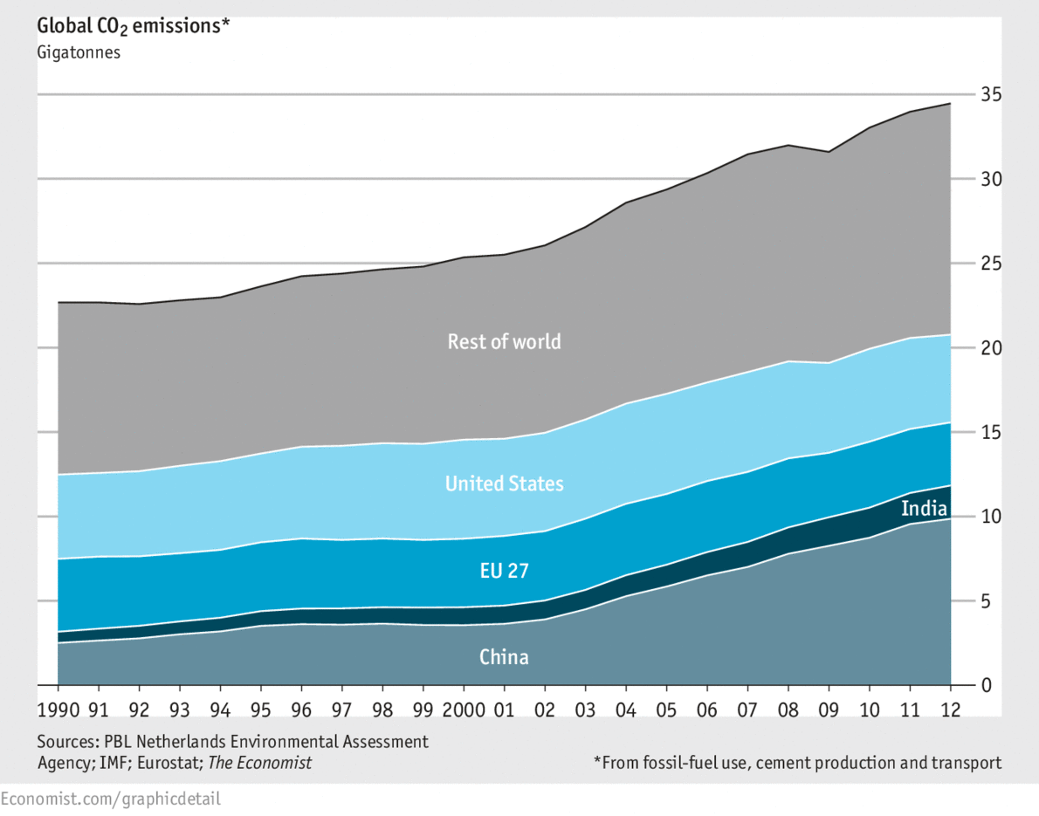
Climate Change
In the last 25 years, CO2 emissions have increased more in emerging economies than in the US and EU.
Notes:
In the last 25 years, carbon dioxide emissions in emerging economies have been increasing. Energy production in emerging economies – especially China and India – is going to be key in reducing the rate of greenhouse gas emissions.
The good news is that in the last two years, carbon dioxide emissions levelled off in China and globally.
Image source: http://www.economist.com/blogs/graphicdetail/2013/11/daily-chart

Slide 26
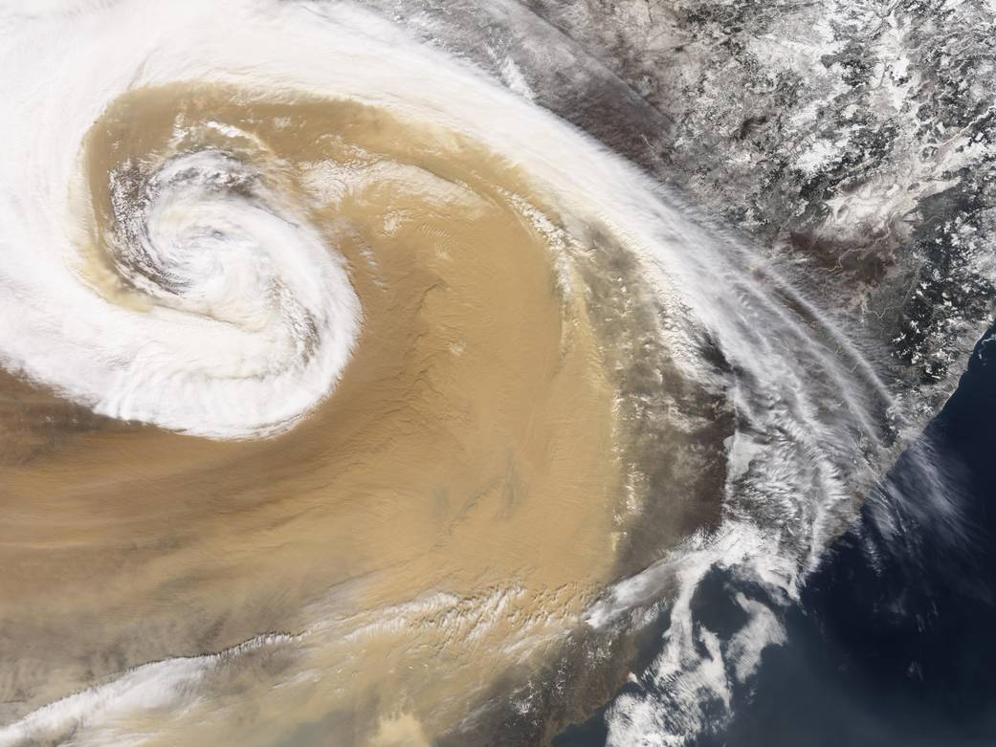
Climate Change
Notes:
The underlying concern with climate change, however: the planet is a complex system, and not even scientists can predict how a changing
climate might radically transform the things critical to human well-being – food, water, shelter.
Image source: http://www.nasa.gov/sites/default/files/images/207401main_image_989_full.jpg

Slide 27
The Challenge, Again
How will a growing population live on a polluted, finite, and changing planet?
Pollution and toxic waste
Deforestation and extinction
Energy demand
Food and water security
Climate change
Notes:
Just to return to the challenge stated earlier: How will a growing population live on a polluted, finite, and changing planet, especially given all of these individual but interconnected issues?
This is the sustainability challenge. Together, they form what could be called a “wicked problem.”

Slide 28
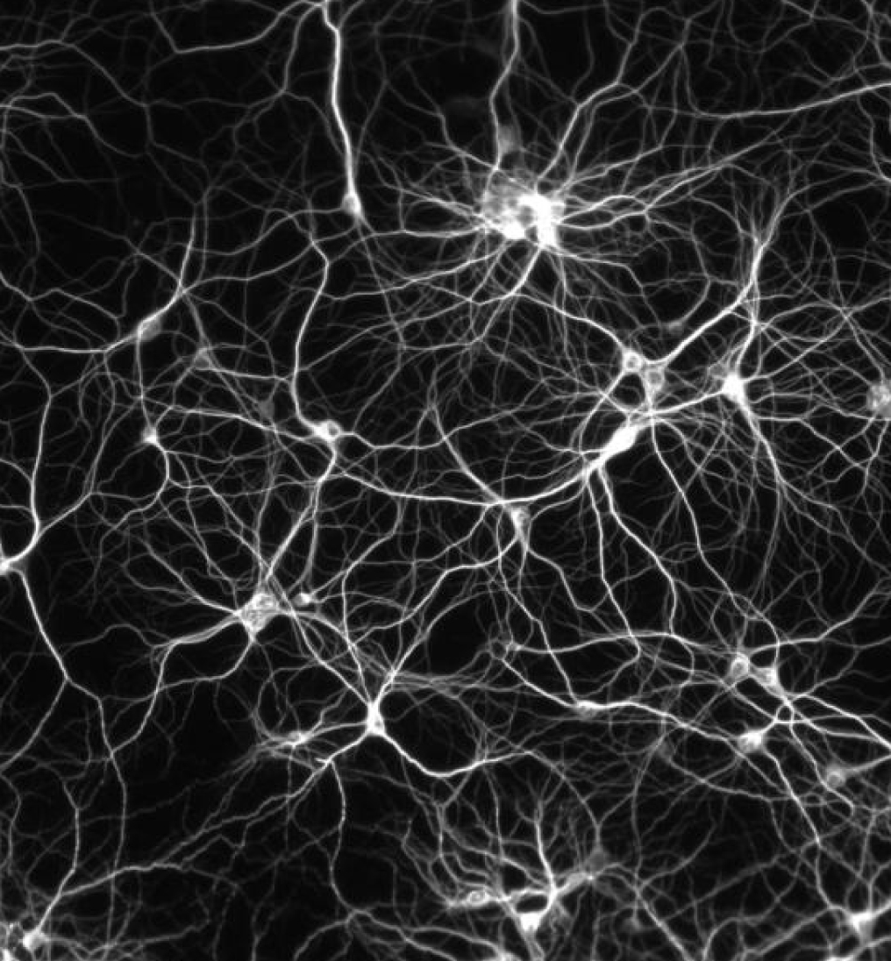
What is a Wicked Problem?
Involves multiple stakeholders, who may disagree on the nature of the problem
Combines environmental, biological, social, cultural, economic and political causes
Continually changes
Solving it often means changing behavior
Solving it often means trade-offs
Can never be completely solved
Notes:
What is a wicked problem and why does it matter?
Wicked problems are problems that are difficult to define, which involve many stakeholders, all of whom might disagree on the nature of the problem. Wicked problems combine environmental, biological, social, cultural, economic and political causes- they are not just simple technological problems. Wicked problems continually change, and solving them often means changing not just technology or regulations but behavior, even cultural attitudes. And solving wicked problems means trade-offs – solutions to one part of the problem might make other aspects of the problem worse. In this sense, the problem can never completely be solved.
Image source: https://freeassociationdesign.files.wordpress.com/2010/04/neuron-map.jpg

Slide 29
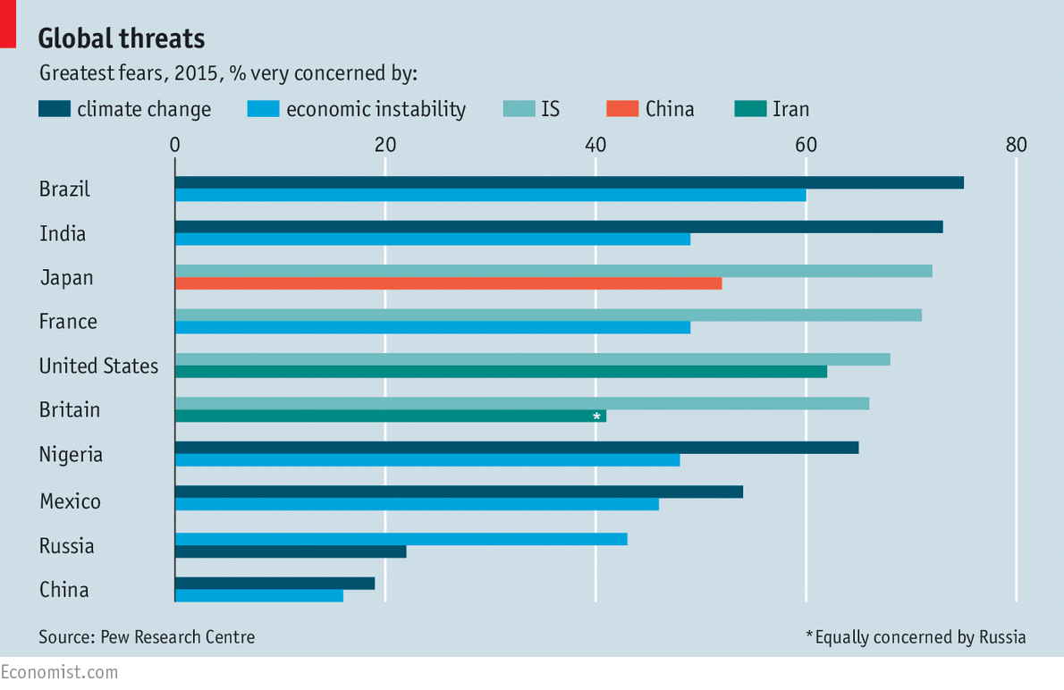
Climate Change: A Wicked Problem
Notes:
Climate change, for instance, is a wicked problem. It has complex causes, and solving it means trade-offs – for instance, renewable energy may emit fewer greenhouse gases, but producing renewable energy may cost more. Reducing carbon emissions may mean changing ingrained cultural behaviors. And, as the image shows, there are many stakeholders who disagree on the nature and importance of the problem. Brazil, India, Nigeria, and Mexico all see it as the greatest global threat; but it is not considered a top concern in the US or UK.
Image source: http://www.economist.com/news/economic-and-financial-indicators/21657796-global-threats

Slide 30
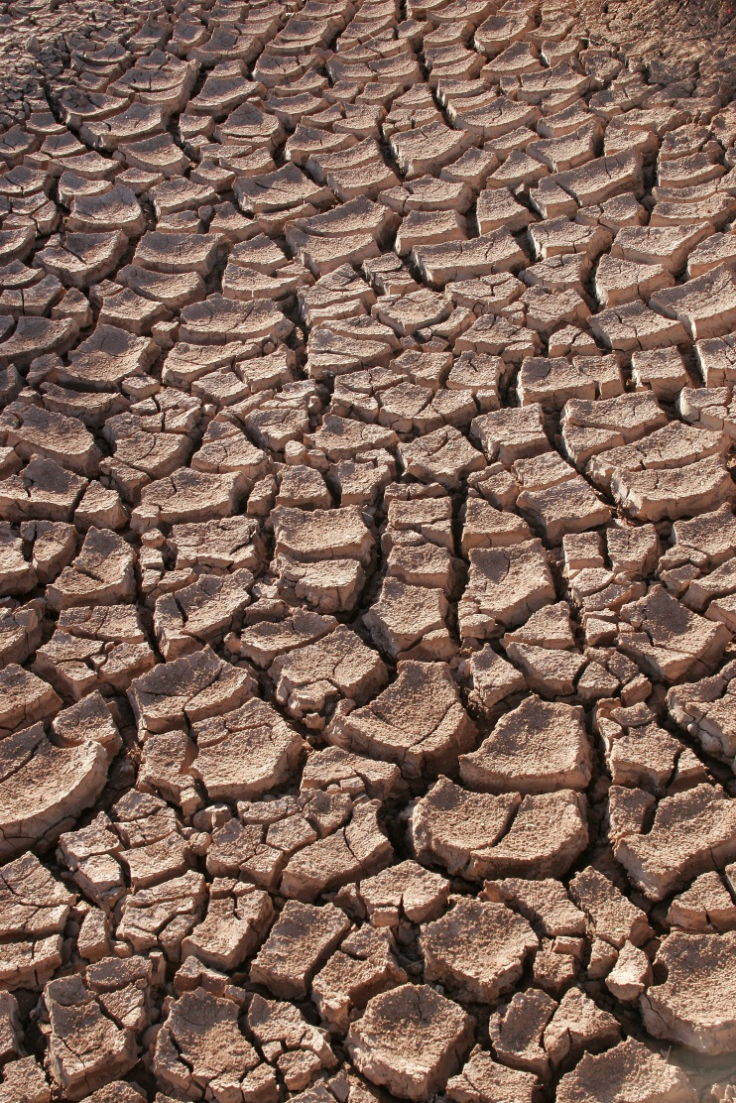
Water Scarcity: A Wicked Problem
Notes:
Water scarcity can also be considered a wicked problem.
It has complex causes - technological, social, economic, environmental factors
It has many stakeholders – farmers, industries, city governments, and entire populations
It requires trade offs: because food production uses so much water, restrictions on water means less food produced.
It can never be completely solved – even with the best technologies and policies in the world, there will likely always be water scarcity somewhere in the world.
Other examples of a wicked problem include: poverty, world hunger, biodiversity loss or extinction, and social inequality. All these issues of sustainability are big, difficult issues with only partial solutions. This does not mean, however, that there are no solutions, or that it is impossible to act.
Image source: https://upload.wikimedia.org/wikipedia/commons/e/e1/Drought.jpg

Slide 31
Sustainable Development
Long-term Thinking and the Triple Bottom Line
Notes:
That brings us to sustainable development and the triple bottom line. How to act, given the challenge of sustainability? One approach is sustainable development.

Slide 32

What is Sustainable Development?
“Sustainable development is development that meets the needs of the present without compromising the ability of future generations to meet their own needs”
- Our Common Future
Notes:
“Sustainable development is development that meets the needs of the present without compromising the ability of future generations to meet their own needs”
This definition comes from a 1987 World Commission on Environment and Development report called Our Common Future – also known as the Brundtland Report. Its definition of sustainable development became the global standard, adopted by the UN at the Rio Conference on Environment and Development in 1992 and in wide use since.

Slide 33
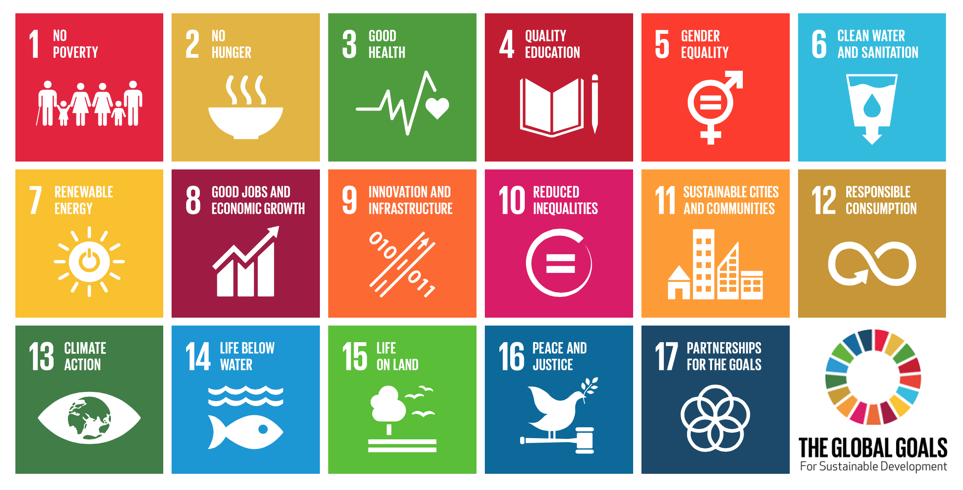
UN Sustainable Development Goals
Notes:
In 2015, the UN defined 17 Sustainable Development Goals. Notice that they combine environmental goals (like responsible consumption and climate action) with social goals (no poverty and reduced inequalities).
Image source: https://en.wikipedia.org/wiki/Sustainable_Development_Goals

Slide 34
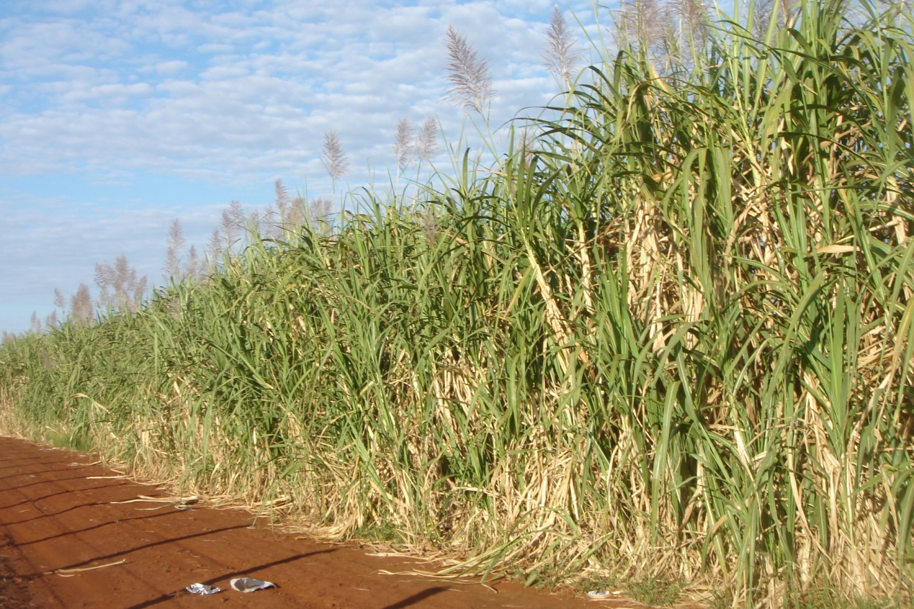
Sustainable Development: Example
Brazil’s energy supply incorporates biofuel production and large hydroelectric power capacity.
Notes:
What do countries do to pursue sustainable development?
Let’s take the example of Brazil.
Brazil’s energy supply incorporates biofuel production and large hydroelectric power capacity.
But Brazil has also pursued social goals:
Programs to support social goals (school attendance, vaccinations, prenatal care)
Electricity to rural areas
With the results that in the last 20 years:
Poverty and malnutrition has declined
Mortality rates fell
Access to drinking water and sanitation increased
Access to electricity has increased
Image source: https://upload.wikimedia.org/wikipedia/commons/5/57/Canaviais_Sao_Paulo_01_2008_06.jpg

Slide 35
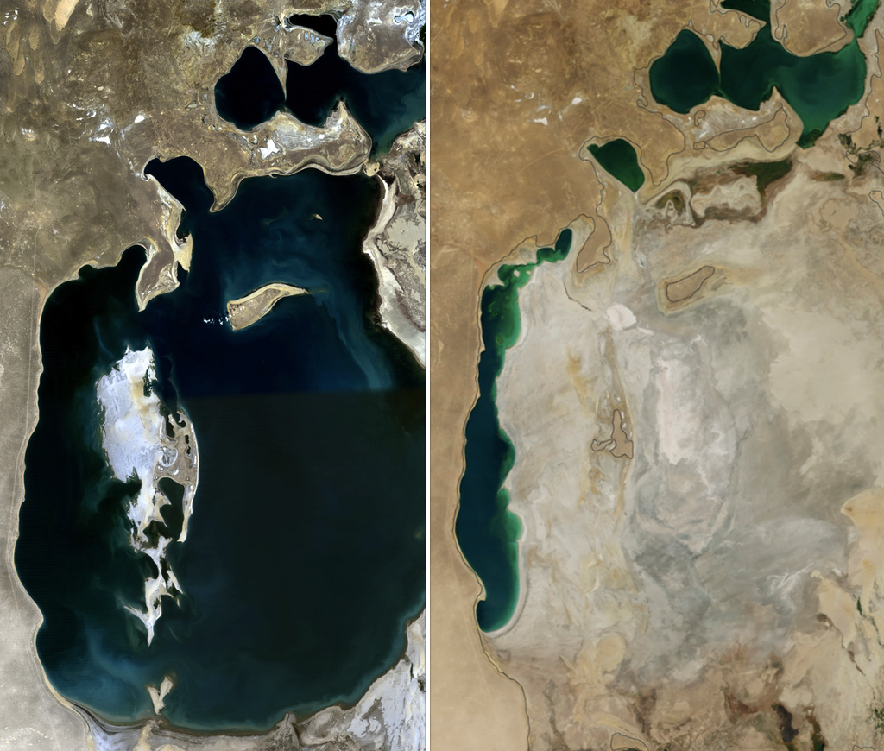
Long-Term Thinking
Aral Sea
(1989)
Aral Sea
(2014)
Notes:
What does sustainable development mean for business?
Sustainable development means long-term thinking. Sustainability by definition means something that can be sustained – maintained, continued – over a long period of time, if not indefinitely.
This means taking into account limited natural resources. A coal mine cannot mine coal forever – eventually the coal runs out. A lumber company cannot cut down more trees than it plants – eventually the trees run out. Farmers cannot continue to use water in a lake such as the Aral Sea faster than it is replenished – eventually it dries up.
It’s not about “living in harmony with nature” or some kind of idealism – it’s simply about not ruining the future.
Image source: https://en.wikipedia.org/wiki/Aral_Sea#/media/File:AralSea1989_2014.jpg

Slide 36
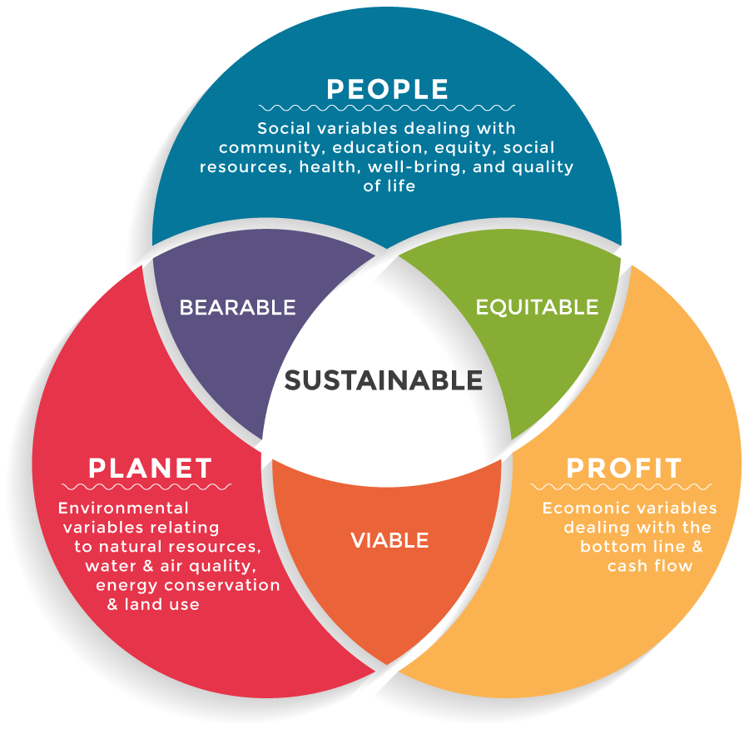
Triple Bottom Line
a way of business accounting that factors in economic, environmental, and social impacts
Notes:
How can we translate sustainable development and long-term thinking into business practice?
The Triple Bottom Line. Instead of just accounting for their financial bottom line, businesses measure and report on their social and environmental behavior.
As you can see here, you can also think of this as “people, profit, and planet.”
Image source: http://www.csrambassadors.com/corporate-social-responsibility-csrambassadors/triple-bottom-line/

Slide 37
Why Triple Bottom Line?
It gives you a conceptual tool for assessing sustainability:
What are a business’s economic, environmental, and social impacts?
Positive impacts = sustainable
Negative impacts = unsustainable
Notes:
Why introduce the Triple Bottom Line now?
The “challenge” presented at the beginning of the presentation is this: in the next century, the world’s population will grow – but its resources will not. How will we solve this wicked problem?
One way to approach it is sustainable development. But what does sustainable development mean for business? It means making a profit without ruining its ability to make future profit in a world of more people and fewer resources.
This idea of the Triple Bottom Line – incorporating economic, environmental, and social accountability – is the foundation for corporate sustainability. As you will find in later weeks, assessing a company’s sustainability means assessing its performance in these three areas. If it has positive financial, environmental and social impacts, then it is sustainable.
Image source: http://www.csrambassadors.com/corporate-social-responsibility-csrambassadors/triple-bottom-line/

Slide 38
Triple Bottom Line: Examples
Reduce toxins used in manufacturing process , improving health of workers and lessening environmental impact
Improve workplace safety, improving the quality of life for workers while reducing turnover and lost hours.
Improve energy efficiency, cutting costs and reducing greenhouse gas emissions
Notes:
Sometimes there are tradeoffs between the three – but the goal of sustainable business practice is to find possibilities for overlaps, or win-wins.
Only by comprehensively thinking about social, environmental, and financial issues can one address comprehensive – “wicked” – problems.
Image source: http://www.csrambassadors.com/corporate-social-responsibility-csrambassadors/triple-bottom-line/

Slide 39
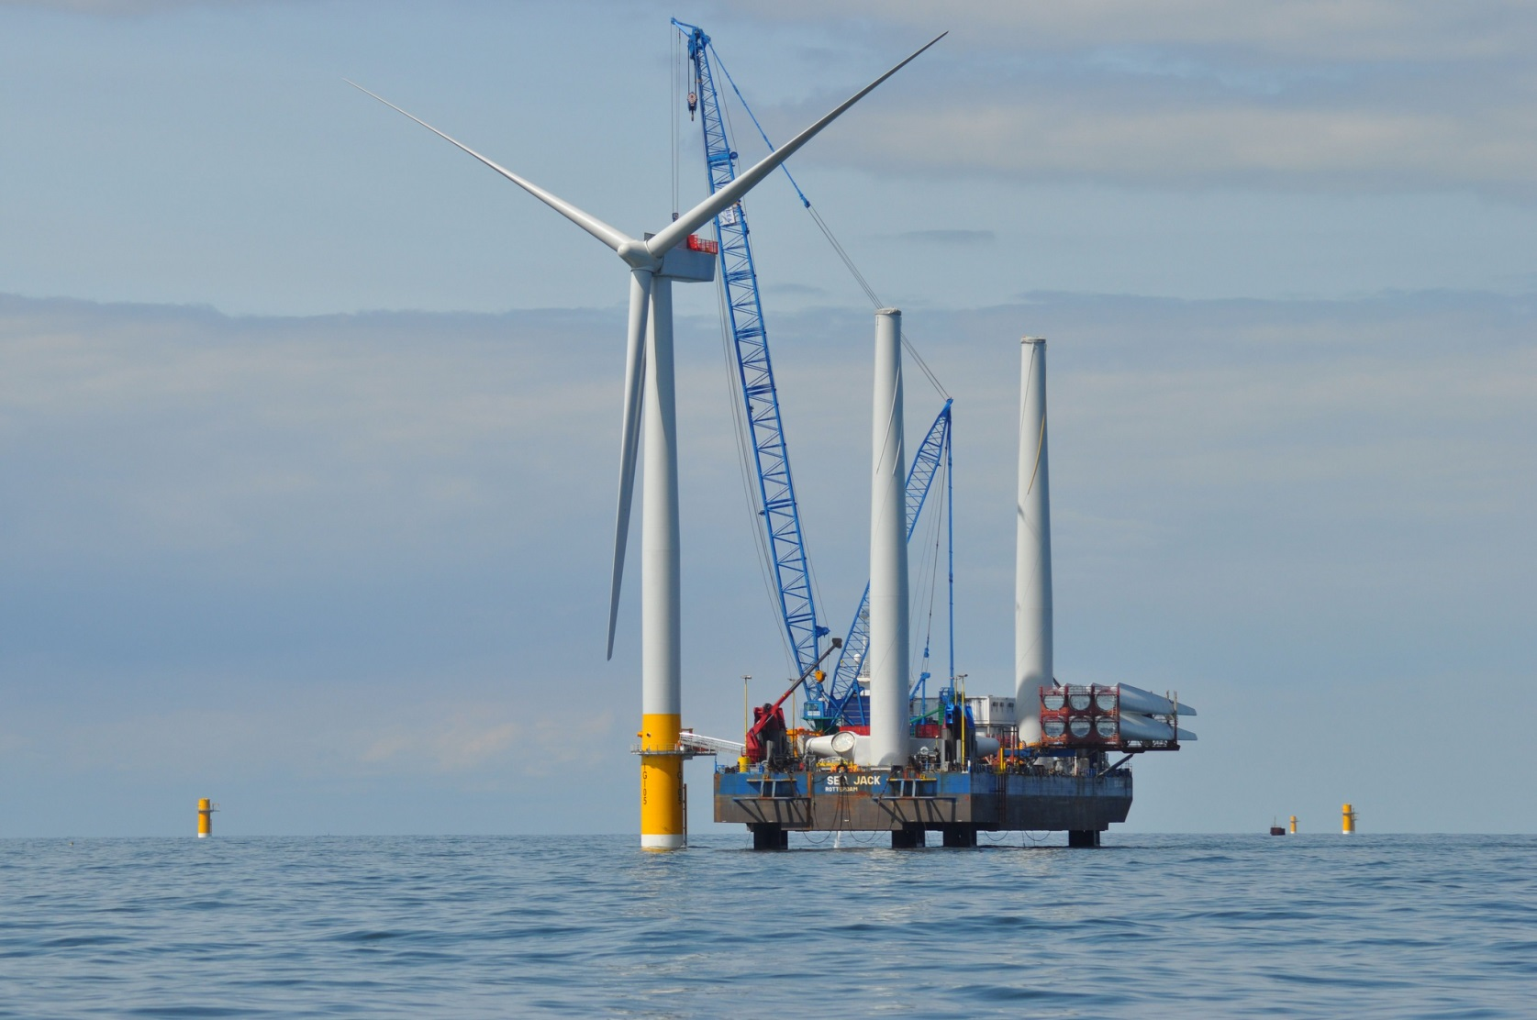
Conclusion: Challenge, Opportunity
Notes:
Let’s conclude by reflecting on the fact that, according to a recent poll, “The environment—and climate change in particular—continues to be rated a top concern for citizens in many countries (Pew Research Centre, 2010)” – UN 2010
At the same time, most sustainability experts are coming to believe that the private sector should play a more important role in leading the sustainble agenda over the next 20 years, as faith diminishes in the ability of national governments to pursue sustainability.
A world with more people and less planet to go around presents a wicked problem – but that does not mean there cannot be any progress. This is where businesses have an opportunity to lead in promoting long term sustainability.
Image source: https://www.flickr.com/photos/deccgovuk/9459566442

Slide 40
Summary
Understanding the Challenge
Global Trends
The “Wicked Problem”
Understanding Sustainable Development
What is Sustainable Development?
The Triple Bottom Line
Conclusion
Summary
Vocabulary Review
Readings and Videos
Assignment

Slide 41
Vocabulary Review
Wicked Problem: A problem that is not easily solved because it has many interconnected causes, many stakeholders, and is continually changing.
Sustainable Development: Development that meets the needs of the present without compromising the ability of future generations to meet their own needs
Triple Bottom Line: A way of business accounting that factors in economic, environmental, and social impacts.

Slide 42
Required Materials
Video
Understanding the Challenge and Sustainable Development, Dr. Michael V. Russo. Available on the course website.
Reading
Green Economy: Realities, Prospects, and Limits To Growth, Boris Porfiriev, Carnegie Moscow Center, 2013.
Please pay special attention to the section “Green Shoots in the Russian Economy”.
You can also access the reading in Russian here.

Slide 43
Supplemental Materials
Videos
What is sustainable development?, United Nations, 11 Sept. 2015.
Sustainability, The Triple Bottom Line, Dr. Karl-Henrik Robert, 30 June 2011.
Business & the value of nature, World Business Council for Sustainable Development, 20 Nov. 2013.
Readings
The BRIC nations’ response to climate change is critical to the fate of the planet, Matthew Wheeland, The Guardian, 4 May 2015.
With the wicked problems of sustainability come wicked opportunities, Andree Gosselin O’Meara, Sustainability Matters Blog, 31 July 2014.
Facts and Trends to 2050, World Business Council for Sustainable Development, 2004.
Report On Implementing The Principles Of Sustainable Development In The Russian Federation, UN Sustainable Development Knowledge Platform, 2012. Available in Russian here.
Website
The Guardian: The New Bottom Line.

Slide 44
Assignment
Based on the required reading and your viewing of this week’s video and slides, please post to the discussion forums a response to the following question:
In your opinion, what is the single most important sustainability challenge Russia faces?
Your response should be roughly 200 words in length. Be sure to read several of your fellow students’ responses as well and provide comments on them.

Slide 45
References
Population trends:
The Economist (2013) “Not Always with Us,” Jun 1, http://www.economist.com/news/briefing/21578643-world-has-astonishing-chance-take-billion-people-out-extreme-poverty-2030-not.
United Nations, Department of Economic and Social Affairs Population Division (2015) World Population Prospects: The 2015 Revision, https://esa.un.org/unpd/wpp/Publications/Files/Key_Findings_WPP_2015.pdf.
McDonald, Charlotte (2015) “How Many Earths Do We Need?” Jun 16, http://www.bbc.com/news/magazine-33133712
Global Footprint Network (2016) “Ecological Wealth of Nations,” http://www.footprintnetwork.org/ecological_footprint_nations.
Air pollution:
United Nations Environment Programme (2016) Actions on Air Quality, http://www.unep.org/transport/airquality/AQ_GlobalReport_Summary.pdf.
Energy demand:
International Energy Agency (2015) World Energy Outlook: Executive Summary http://www.worldenergyoutlook.org/resources/energydevelopment [available in Russian at http://www.iea.org/publications/freepublications/publication/world-energy-outlook-2015---executive-summary---russian-version.html].
Pederson, Chris (2014) “Access To Energy Explains Unequal Growth Rates of India and China,” OilPrice.com, Jul 16, http://oilprice.com/Energy/Energy-General/Access-To-Energy-Explains-Unequal-Growth-Rates-of-India-and-China.html.
United Nations Water (2014) “World energy consumption increased by 186% between 1973 and 2010,” Oct. 7, http://www.unwater.org/statistics/statistics-detail/en/c/246692/
United States Energy Information Administration (2016) International Energy Outlook 2016, May 11, http://www.eia.gov/forecasts/ieo/world.cfm.
Water and food security:
Grady, Heather (2013) “Three Trends Shaping the Future of Food Security,” Jul. 3, https://www.rockefellerfoundation.org/blog/three-trends-shaping-future-food.
World Business Council for Sustainable Development (2006) “Facts and Trends,” http://www.unwater.org/downloads/Water_facts_and_trends.pdf.
United Nations Water (2014) “Agriculture is the biggest water user, with irrigation accounting for 70% of global water withdrawals,” Oct. 7, http://www.unwater.org/statistics/statistics-detail/en/c/246663.
United Nations Water (2014) “Water Quality,” Oct. 7, http://www.unwater.org/statistics/statistics-detail/en/c/260727.
World Food Program (2016) “ Hunger Statistics,” https://www.wfp.org/hunger/stats.
Climate change
The Economist (2016) “The world’s carbon-dioxide emissions have stabilised," Mar. 16, http://www.economist.com/news/business-and-finance/21694972-they-need-fall-have-real-impact-climate-change-worlds-carbon.
World Resources Institute (2015) “Infographic: What Do Your Country's Emissions Look Like?“ Jun. 23, http://www.wri.org/blog/2015/06/infographic-what-do-your-countrys-emissions-look.
Wicked Problems
Australian Public Service Commission (2007) Tackling Wicked Problems: A Public Policy Perspective, http://www.apsc.gov.au/__data/assets/pdf_file/0005/6386/wickedproblems.pdf.
Sustainable Development
World Commission on Environment and Development (1987) Our Common Future http://www.un-documents.net/our-common-future.pdf.
United Nations Sustainable Development Knowledge Platform (2015) Sustainable Development Goals, https://sustainabledevelopment.un.org/?menu=1300.
United Nations Development Program (2012) Triple Wins for Sustainable Development, http://www.undp.org/content/dam/undp/library/Cross-Practice%20generic%20theme/Triple-Wins-for-Sustainable-Development-web.pdf.
Triple Bottom Line
Slaper, T.F. and T. Hall (2011) “The Triple Bottom Line: What Is It and How Does It Work?” Indiana Business Review 86(1), http://www.ibrc.indiana.edu/ibr/2011/spring/article2.html
The Economist (2009) “Triple Bottom Line,” Nov. 17, http://www.economist.com/node/14301663.
GlobeScan (2015) “The 2015 Sustainability Leaders” May 28, http://www.globescan.com/component/edocman/?view=document&id=179&Itemid=591.

Slide 46
Image Credits
Slide 5: Population Growth: http://www.un.org/News/dh/photos/large/2015/July/Population-Infographic-01.jpg
Slide 6: Population Growth: http://www.un.org/News/dh/photos/large/2015/July/Population-Infographic-02.jpg
Slide 7: Decrease in Extreme Poverty: http://www.economist.com/news/briefing/21578643-world-has-astonishing-chance-take-billion-people-out-extreme-poverty-2030-not
Slide 8: Development → Consumption: http://oilprice.com/Energy/Energy-General/Access-To-Energy-Explains-Unequal-Growth-Rates-of-India-and-China.html
Slide 9: Development → Over-Consumption: https://upload.wikimedia.org/wikipedia/commons/d/db/Nasa_blue_marble.jpg
Slide 10: The Challenge: https://upload.wikimedia.org/wikipedia/commons/d/db/Nasa_blue_marble.jpg
Slide 11: Air Pollution: http://visuals.datadriven.yale.edu/pollution-map
Slide 12: Toxic Waste: Kevin McElvaney/Al Jazeera (http://www.aljazeera.com/indepth/inpictures/2014/01/pictures-ghana-e-waste-mecca-2014130104740975223.html)
Slide 13: Deforestation and Extinction: Rainforest: https://upload.wikimedia.org/wikipedia/commons/d/d0/Aerial_view_of_the_Amazon_Rainforest.jpg. De-deforestation: http://www.economist.com/news/science-and-technology/21603409-how-brazil-became-world-leader-reducing-environmental-degradation-cutting. Fewer farewells: http://www.unisi.it/sites/default/files/allegatiparagrafo/theeconomist_20130914_biodiversity_0.pdf
Slide 14: Energy Demand: http://www.princeton.edu/~ina/images/infographics/lights_earth.jpg
Slide 15: Energy Demand: http://www.eia.gov/forecasts/ieo/world.cfm
Slide 16: Energy Demand: http://www.eia.gov/forecasts/ieo/world.cfm
Slide 17: Energy Demand: http://www.economist.com/blogs/graphicdetail/2015/04/daily-chart-6
Slide 18: Food and Water Security: https://www.agric.wa.gov.au/sites/gateway/files/Wheat%20_Z056804_0.jpg
Slide 19: Food and Water Security: http://www.unep.org/dewa/vitalwater/article43.html
Slide 20: Food and Water Security: FAO: http://eumindgogreen13.weebly.com/uploads/5/1/2/6/51264535/7209274.jpg?1451479828
Slide 21: Food and Water Security: https://upload.wikimedia.org/wikipedia/commons/7/74/River_algae_Sichuan.jpg
Slide 22: Climate Change: http://climate.nasa.gov/interactives/climate-time-machine
Slide 23: Climate Change: http://www.wri.org/sites/default/files/world_ghg_flow_chart_2005.png
Slide 24: Climate Change: http://www.wri.org/blog/2015/06/infographic-what-do-your-countrys-emissions-look
Slide 25: Climate Change: http://www.economist.com/blogs/graphicdetail/2013/11/daily-chart
Slide 26: Climate Change: http://www.nasa.gov/sites/default/files/images/207401main_image_989_full.jpg
Slide 27: The Challenge, Again: https://upload.wikimedia.org/wikipedia/commons/d/db/Nasa_blue_marble.jpg
Slide 28: What is a Wicked Problem? https://freeassociationdesign.files.wordpress.com/2010/04/neuron-map.jpg
Slide 29: Climate Change: A Wicked Problem: http://www.economist.com/news/economic-and-financial-indicators/21657796-global-threats
Slide 30: Water Scarcity: A Wicked Problem: https://upload.wikimedia.org/wikipedia/commons/e/e1/Drought.jpg
Slide 33: UN Sustainable Development Goals: https://en.wikipedia.org/wiki/Sustainable_Development_Goals
Slide 34: Sustainable Development Example: https://upload.wikimedia.org/wikipedia/commons/5/57/Canaviais_Sao_Paulo_01_2008_06.jpg
Slide 35: Long Term Thinking: https://en.wikipedia.org/wiki/Aral_Sea#/media/File:AralSea1989_2014.jpg
Slide 36: Triple Bottom Line: http://www.csrambassadors.com/corporate-social-responsibility-csrambassadors/triple-bottom-line/
Slide 37: Triple Bottom Line: http://www.csrambassadors.com/corporate-social-responsibility-csrambassadors/triple-bottom-line/
Slide 38: Triple Bottom Line: http://www.csrambassadors.com/corporate-social-responsibility-csrambassadors/triple-bottom-line/
Slide 39: Conclusion: https://www.flickr.com/photos/deccgovuk/9459566442

